Slide 1
Student Mental Health Analysis
Analysed in Jupyter using Python Libraries such as Matplotlib,Numpy,Pandas and Seaborn
Data Source:
https://www.kaggle.com/datasets/junnn0126/university-students-mental-health

Slide 2

Outline:
Introduction
Data Sources
Documentation of cleaning and manipulation
Summary of Data Analysis
Key Visualisations and Findings
Summary

Slide 3
Introduction:
Objective: My name is Eryk, and I am responsible for conducting the following Exploratory Data Analysis (EDA) on Mental Health Data. This project was created to further enhance my understanding of real-world data and to strengthen my ability to derive meaningful insights from public health datasets.
The primary goal of this analysis is to explore how factors such as age, gender, study hours, and CGP’s relate to mental health conditions. Throughout this analysis, I placed particular emphasis on the importance of thorough data cleaning and manipulation — a key learning point that significantly influenced the quality of the visualisations and the accuracy of the findings. I will highlight a specific example later that shows how a simple oversight during cleaning could have skewed the analysis entirely.
Why This Dataset Is Valuable: The mental health dataset used in this project is particularly suitable for exploratory data analysis because:
It contains a rich variety of features, including demographic, social, and behavioral attributes.
It allows for multi-dimensional analysis, such as correlations between age and depression, or gender and treatment-seeking behaviour.
The data offers a real-world perspective on mental health, supporting both descriptive insights and hypothesis-driven exploration. Its structure is ideal for both visualization and potential machine learning applications, making it a flexible and practical learning resource.
The Problem: Mental health issues, especially among students and working professionals, are rising globally — yet they remain underreported and misunderstood. Identifying patterns and risk factors from self-reported data can help uncover key areas where awareness, support systems, or interventions are lacking.
Key Questions I Set Out to Answer:
Are certain age groups or genders more vulnerable to mental health issues?
What courses require the most concentration ?
Are external factors like study hours or work interference linked to mental health?

Slide 4

Data Source:
The dataset used in this analysis was sourced from Kaggle and focuses on the mental health of university students. It contains a range of features that cover demographic details (such as age and gender), academic factors (like study hours and course of study), and mental health indicators (such as depression, anxiety, and stress). This dataset is particularly valuable because it reflects real-world, self-reported information from students, offering an authentic look into the psychological pressures faced by young adults. The diversity of variables allows for multi-angle exploration—whether analysing trends across age groups, or investigating how family history or academic stress relate to mental health outcomes. Given the rising awareness and importance of mental health, especially in academic environments, this dataset presents a meaningful opportunity to extract insights that are both socially relevant and analytically rich.

Slide 5

Documentation of Manipulation and Cleaning

Slide 6
Step by Step of Cleaning my Data
Step 1 - The first step after loading the data was to check whether there are any outstanding values such as any age group being out of order or the hours being too unrealistic for this specific data set.
Step 2 - Create a copy of the file, just in case if we wish to come back to the original state after the editing is done.
Step 3 - Find if there are any missing values. If there are, adjust or delete them. Luckily in this data set there were none.
Step 4 - The following step was to rename some of the column names to make the readability more attractive for the final user/ employer.
Step 5 - Finally, load in the data (preferably the first five columns) in order to analyse and confirm the changes.

Slide 7
Summary Continued:
Summary analysis was carried out on the dataset and the following statistics were taken:
Pie chart showing the percentages of Males and Females
Age distribution in a bar chart
Heatmap showing where the ‘No’ responses occurred
Top 3 most popular courses with the male/female comparison
Bar chart showing different ages of both male and female students
Popular courses from the most to the least
CGPA distribution
Sleep Quality vs CGPA
Stress Level vs CGPA
Anxiety Percentage by Study Year
ScatterPlot showing study hours vs CGPA by stress level
Academic Engagement over time
Depression amount per age
Support Percentage by year group
Sleep quality vs specialist treatment
Violinplot showing the stress level by age
Most popular case between the anxiety, panic attack and depression
Top 3 courses with the biggest study amount
Academic engagement vs CGPA
Percentage of study hours per year

Slide 8

Key Findings

Slide 9

Key Findings 1:
There were no missing values in the dataset. Furthermore, no outstanding values could be seen.
In the dataset, there were much more female to male students. This is a 76% to 24% ratio.
The most students that took part in this dataset were junior students - age 18.
Out of 1000 people that were in the dataset, most admitted that they don’t have any support or special treatment.
Engineering is the most in demand course, being the leader with a significant difference.
The least in demand subject was psychology.
Out of all of the students, the average CGPA score was 4.0 which is outstanding.
In year two, students slept less, meaning that their overall CGPA score was much lower.
The highest stress level could be noticed in year 1 and 3 affecting the students health.
Anxiety percentage was the highest in year 2, does this correlate with the sleep pattern?

Slide 10
Key Findings 2:
It is clearly seen that the more students spend studying, the better score they get.
The most recent year, had the lowest amount of student engagement.
The ages with the highest depression were 18-19.
In year 2, students had the most support from teachers and third party sources, closely followed by year 1.
Specialist treatment does have a positive impact on the students sleep patterns.
The highest stress level could be seen at age 21 ( year 2).
Most repeated mental health case that occured in this survey was depression.
Engineering had the most study hours.
If a student committed fully to their academic year, their CGPA would be higher.
It could be seen that the first year had the largest amount of study hours, because of new school pressure?

Slide 11

Key Visualisation

Slide 12
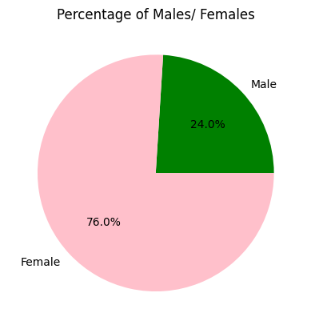
Chart 1: Percentage of Males/ Females
Chart Summary: The pie chart shows the gender distribution of respondents in the dataset. It reveals a significant imbalance in the sample composition:
Female respondents make up 76% of the total.
Male respondents account for only 24%.
Interpretation:
This indicates that the majority of participants in this mental health study are female, which could reflect either higher female engagement in mental health surveys or gender-related patterns in mental health reporting.
The underrepresentation of male respondents suggests that any gender-based comparisons (e.g., prevalence of depression by gender) must be interpreted cautiously. There is a risk of bias due to sample imbalance.
From a broader perspective, this pattern may also highlight a potential stigma among males in acknowledging or discussing mental health issues—something that’s often reported in academic literature and public health research.
Key Takeaway: While the dataset provides valuable insights, gender representation should be considered when generalizing findings or making policy recommendations.

Slide 13
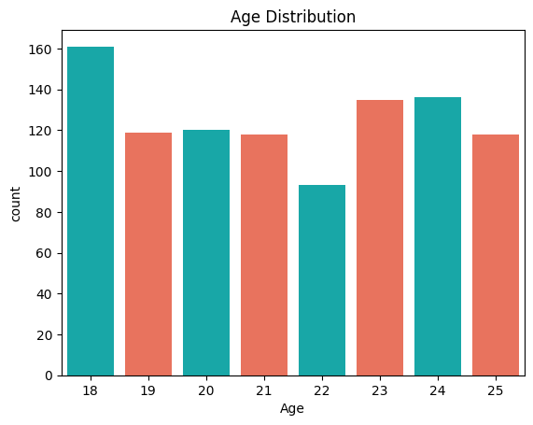
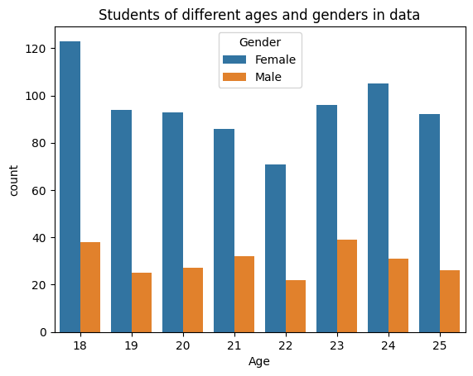
Chart 2 & 3: Age & Gender Distribution
Chart 1: Students of Different Ages and Genders
Females significantly outnumber males in all age groups.
Age 18 shows the highest participation, especially among females.
Male representation remains consistently lower across all ages.
Chart 2: Age Distribution
Majority of respondents are between ages 18–25, with age 18 being the most common.
Participation is fairly balanced across the rest of the age range, suggesting a good spread for analysis.

Slide 14
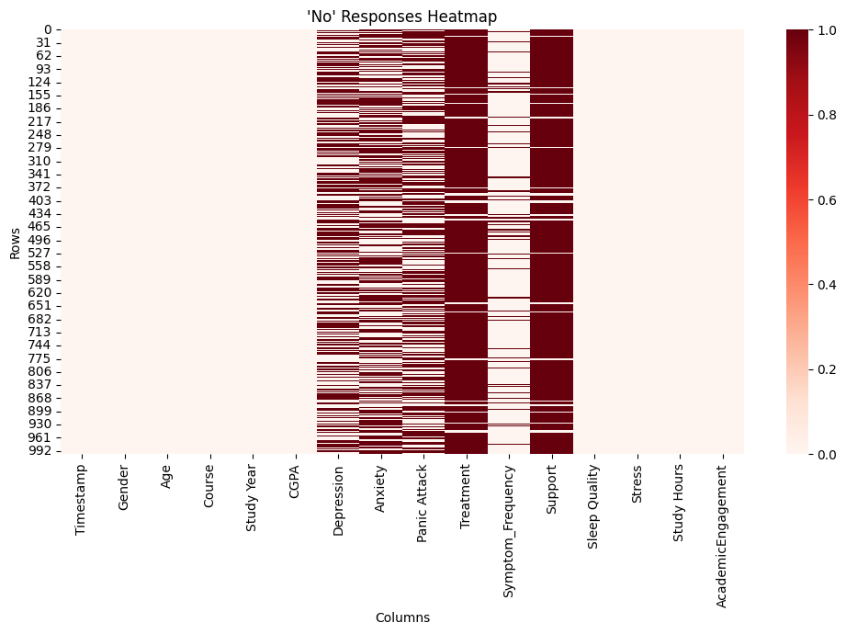
Chart 4: ‘No’ Response Heatmap
This heatmap visualizes the frequency of "No" responses across key mental health-related columns.
The darkest areas indicate that a large number of participants denied experiencing depression, anxiety, panic attacks, or needing treatment.
Despite high "No" rates, there's still noticeable variation — some rows show clusters of "Yes" responses, especially in columns like Anxiety and Support, which indicates mixed experiences.
The chart also shows that non-mental health columns (like Age, Gender, CGPA) have no "No" values, confirming they're mostly numeric or non-binary.
Takeaway: While many participants reported no mental health issues, there is a significant minority with positive responses, which makes this dataset valuable for identifying patterns and risk factors.

Slide 15
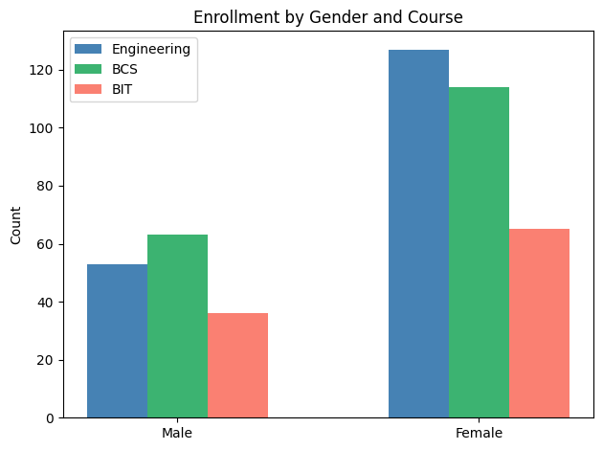
Chart 5: Enrollment by Gender and Course
Female students dominate enrollment across all three programs — Engineering, BCS (Computer Science), and BIT (Information Technology).
Engineering has the highest overall enrollment, especially among females.
Male students are more evenly distributed across courses but in smaller numbers overall.
BCS has slightly more male participants compared to Engineering and BIT.
Takeaway: The distribution shows a strong female presence in technical fields, which might influence course-specific mental health trends explored later.

Slide 16
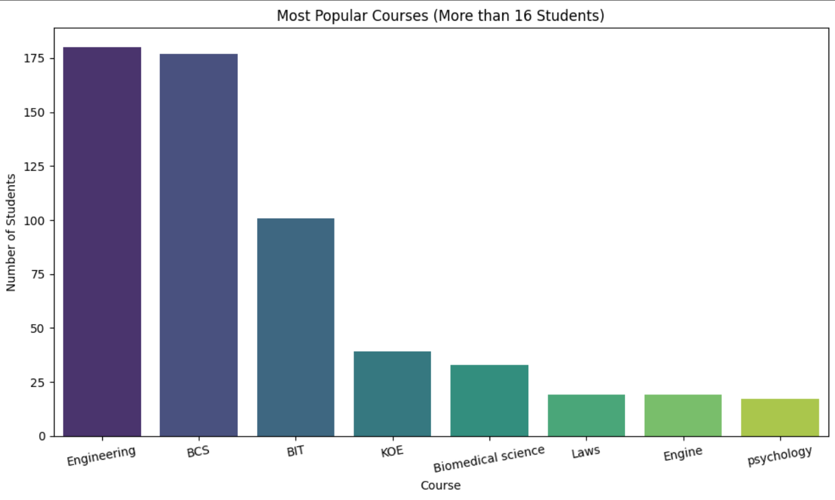
Chart 6: Most Popular Courses
Engineering and BCS (Computer Science) are the most popular courses, each with around 180 students.
BIT (Information Technology) follows as the third most common with just over 100 students.
Other fields like KOE, Biomedical Science, and Law have notably fewer students, ranging from ~20 to 40.
Courses like Psychology and Engine have the lowest representation.
Takeaway: The dataset is heavily dominated by technical and computing-related courses, which may influence overall patterns in academic pressure or mental health indicators.

Slide 17
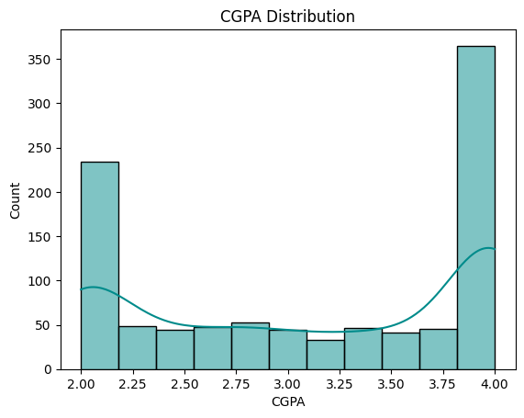
Chart 7: CGPA Distribution
The distribution is bimodal, with two clear peaks at 2.0 and 4.0, indicating many students are either at the lower or upper extremes of academic performance.
A significant number of students have a perfect 4.0 CGPA, followed closely by those clustered at 2.0.
The middle range (2.5–3.5) has comparatively fewer students, showing a polarization in academic achievement.
Takeaway: This unusual pattern suggests that some students either excel academically or struggle considerably—potentially correlating with mental health or stress-related factors to be explored later.

Slide 18
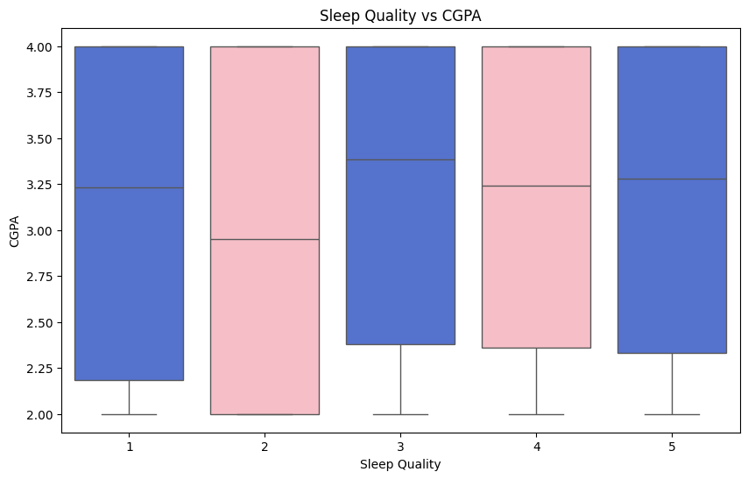
Chart 8: Sleep Quality vs CGPA
Students across all sleep quality levels (1–5) show a wide range of CGPAs from 2.0 to 4.0.
Median CGPA is slightly higher for those reporting better sleep quality (3–5).
The lowest median CGPA appears around sleep quality level 2, suggesting poor sleep may slightly affect performance.
However, the variation within each group is large — no strong correlation is visually evident.
Takeaway: While better sleep might support slightly better academic performance, it's not a strong predictor of CGPA on its own.

Slide 19
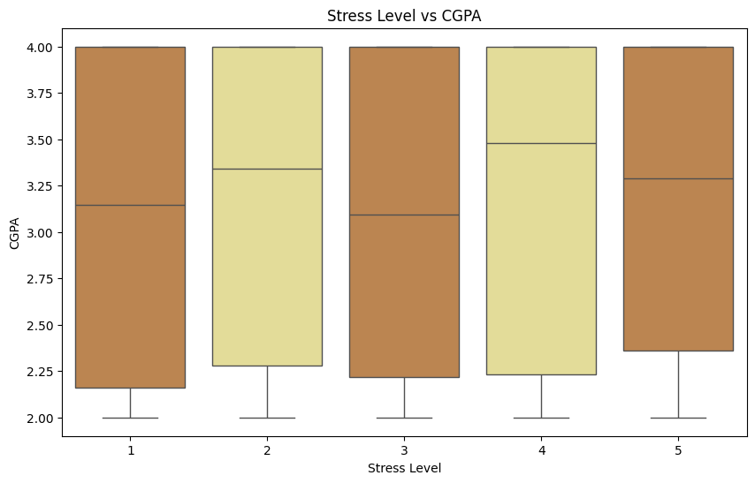
Chart 9: Stress Level vs CGPA
CGPA values remain fairly consistent across all stress levels (1–5).
Median CGPA does not show a strong downward trend with increasing stress.
Students with moderate to high stress (3–5) still perform comparably to those with lower stress.
Wide range of CGPAs at all levels suggests that stress alone is not a reliable predictor of academic performance.
Takeaway: While stress is often assumed to hinder performance, the data suggests no clear impact of stress levels on CGPA in this group.

Slide 20
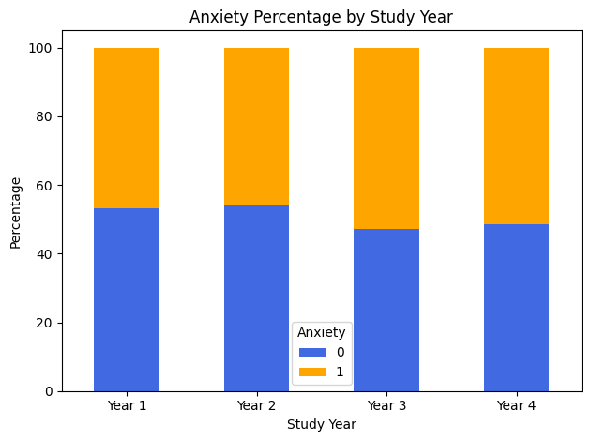
Chart 10: Anxiety Percentage by Study Year
Year 1 and Year 2 students show similar anxiety levels: ~53–54% report no anxiety.
Year 3 sees a notable increase in anxiety: ~53% report experiencing anxiety.
Slight recovery in Year 4, but anxiety levels remain high.
Insights:
Anxiety peaks in Year 3, possibly due to academic workload, internships, or looming graduation pressures.
Trends suggest the need for targeted mental health support, particularly for mid-program students.

Slide 21
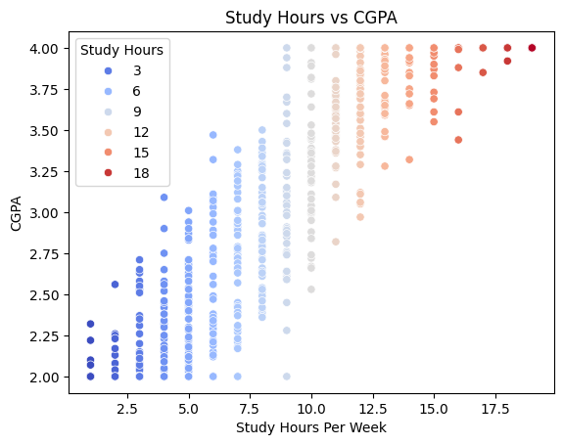
Chart 11: Study Hours vs CGPA
The chart clearly shows a positive correlation between weekly study hours and CGPA. Students who dedicate more time to studying—particularly those studying 12 hours or more per week—tend to achieve higher academic performance.
Lower study durations are generally associated with lower CGPAs, and the trend becomes more consistent as study hours increase. The colour gradient further reinforces how higher study time aligns with academic success, suggesting the importance of disciplined study habits in achieving top grades.

Slide 22
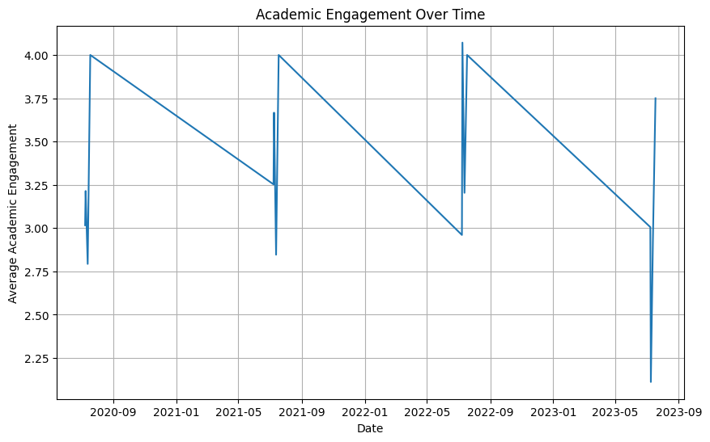
Chart 12: Academic Engagement over time
This line graph illustrates the average academic engagement of students across different time periods from 2020 to 2023. The trend shows periodic fluctuations, with peaks reaching around 4.0 in engagement and some noticeable dips. These variations could reflect academic calendar cycles, such as exam periods or semester breaks, influencing students’ engagement levels. Overall, the engagement remains relatively high, but the dips indicate times when students may be less involved or motivated academically.
When we compare September of 2020 to September of 2023, we can gather that the students focus much less in the latest year, this could be to many factors, such as coming back to school after the COVID time has finished.

Slide 23
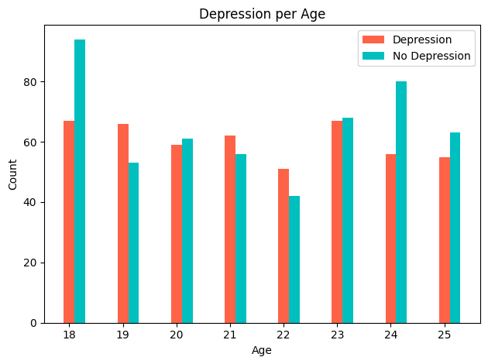
Chart 13: Depression per Age in Count
The graph compares the number of students experiencing depression versus those not experiencing depression across different ages from 18 to 25. At age 18, the number of students without depression is noticeably higher than those with depression. For ages 19 to 23, the counts of students with and without depression are relatively close, showing some variation but no large gap. At age 24, the number of students without depression significantly surpasses those with depression, while at age 25, the counts are again more balanced but with slightly more students without depression. Overall, this graph reveals fluctuations in depression prevalence across age groups, with some ages showing more balanced distributions and others showing a greater proportion without depression.

Slide 24
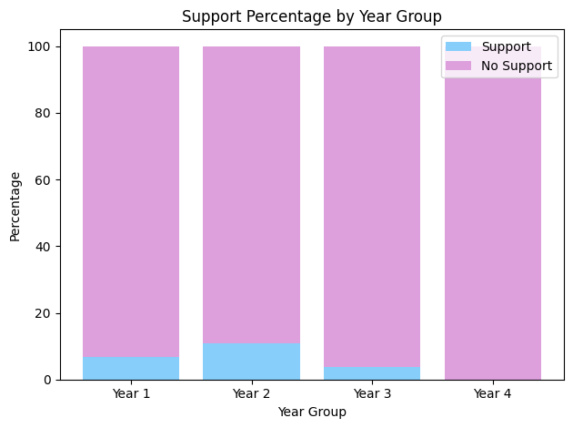
Chart 14: Support Percentage by Year Group
The graph illustrates the percentage of students receiving support versus those not receiving support across four different year groups. In Year 1, a small percentage of students receive support, with the majority not receiving any. Year 2 shows the highest support percentage among all year groups, though the majority still do not receive support. Year 3 has a lower support percentage compared to Year 2, with most students not receiving support. Year 4 has no students receiving support, with the entire group falling under no support.
This trend indicates that support availability or uptake tends to decrease as students progress through their years of study.

Slide 25
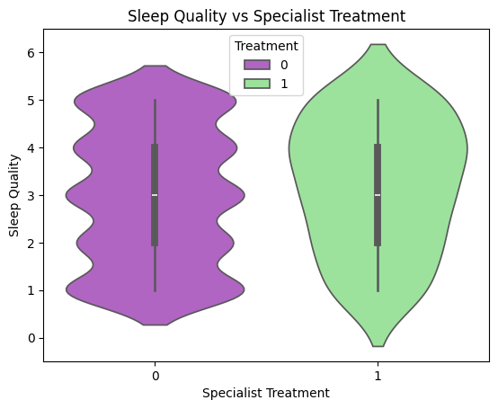
Chart 15: Sleep Quality vs Specialist Treatment
The Sleep Quality vs Specialist Treatment violin plot shows the distribution of sleep quality scores for individuals who did and did not receive specialist treatment.
On the left, those without treatment (indicated by 0) have a fairly symmetrical distribution centered around a sleep quality score of 3. The majority of responses fall between 2 and 4, suggesting a moderate but consistent level of sleep quality.
On the right, those who received treatment (indicated by 1) show a wider distribution. While the median sleep quality remains similar, this group includes more individuals with very low and very high sleep quality scores, indicating greater variability. This suggests that while treatment doesn't drastically shift the average sleep quality, it may be associated with more diverse outcomes—some individuals benefit significantly, while others do not.

Slide 26
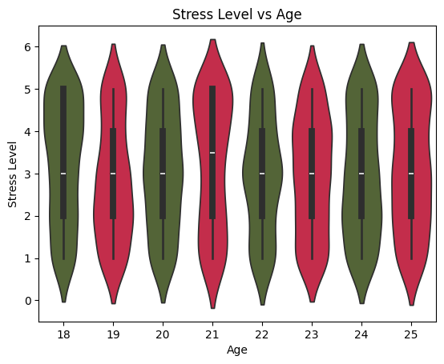
Chart 16: Stress Level vs Age
Overall Distribution: Across all age groups (18 to 25), stress levels are spread across the entire 1–5 range, suggesting that high and low stress are common at all ages.
Subtle Age Differences:
Age 18 and 21: These age groups show a slightly wider distribution, especially toward higher stress levels (4–5), indicating that individuals in transitional phases (e.g., entering or midway through university) may be more likely to report higher stress.
Ages 19, 20, 22, 23: These groups show a slightly more balanced or symmetrical distribution, hinting at a more moderate or stable stress experience during these years.
Ages 24 and 25: The density is more pronounced at stress levels 3–4, with less presence at the extremes. This could reflect coping improvements or reduced academic/social pressure as individuals approach graduation or early career stages.
Consistency in Median Stress: Despite the varying spreads, the median stress level appears fairly consistent (around 3), reinforcing the idea that while individuals differ widely, the central tendency does not shift dramatically with age.
In summary, while stress is widespread across all age groups, individuals at the beginning and midpoint of their academic journey (18 and 21) might be particularly prone to elevated stress levels, potentially due to adjustment challenges or academic pressure peaks.

Slide 27
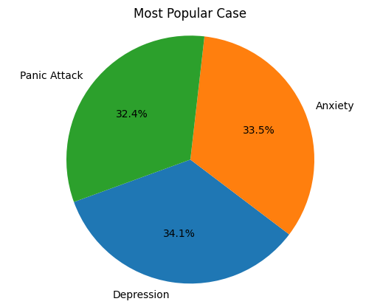
Chart 17: Most Popular Case
The pie chart titled "Most Popular Case" presents a fairly even distribution among three mental health issues—Depression (34.1%), Anxiety (33.5%), and Panic Attack (32.4%)—but with meaningful distinctions:
Depression slightly leads as the most frequently reported condition, albeit by a narrow margin. Its prevalence suggests that it may be the most recognized or diagnosed issue among the sample population.
Anxiety is a very close second, only 0.6 percentage points behind Depression. This near-equal share implies a high co-occurrence or intertwined experience with Depression, which aligns with known psychological comorbidity trends.
Panic Attacks, while just slightly less prevalent (32.4%), are still reported by nearly one-third of the group. This highlights that acute episodes of extreme stress are common and cannot be overlooked.
Interpretation:
The minimal spread (under 2%) across all three categories suggests that these mental health concerns are almost equally significant in this population.
It may point toward a need for holistic mental health interventions that address the interconnected nature of these issues rather than treating them in isolation.
Additionally, the high overall reporting of each case type may reflect growing awareness, reduced stigma, or elevated stress environments such as academia or early career life stages.
In summary, Depression is marginally the most common concern, but the data strongly emphasizes that Anxiety and Panic Attacks are equally pressing issues—together forming a triad that likely coexists and impacts the same individuals.

Slide 28
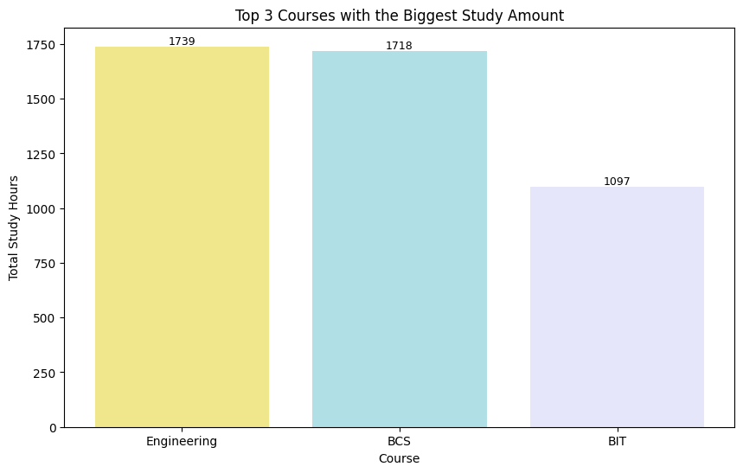
Chart 18: Top 3 Courses with the Highest Study Amount
Engineering and BCS demand high study engagement:
The near-identical totals suggest these two courses have similar academic rigor or student work ethic expectations.
It could also reflect structured curriculums with consistent assessment loads or time-intensive content (e.g., labs, projects, coding).
BIT shows a substantial drop:
The difference of over 600 hours compared to BCS and Engineering is notable.
This might indicate:
A lighter curriculum structure,
More project-based or practical work not reflected in study hour logging,
Or even a potential lack of engagement or underreporting from students in the BIT program.
Competitive nature of Engineering and BCS:
These figures could also reflect the competitive pressure within these fields, where students often study more to stay ahead or meet demanding standards.

Slide 29
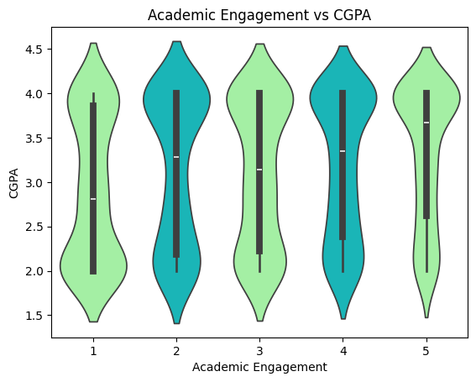
Chart 19: Academic Engagement vs CGPA
Consistent Median CGPA Across Levels: The median CGPA across engagement levels (1 through 5) appears relatively stable, mostly hovering between 3.0 and 3.4.
Broader Distribution at Lower Engagement (1–2): Engagement levels 1 and 2 show a wider CGPA spread, with noticeable tails extending toward lower GPA values (~2.0). This suggests greater variability in academic performance among students with low engagement.
Higher Engagement (4–5) Shows Slight Improvement: Levels 4 and 5 have tighter distributions and higher minimum CGPA thresholds, indicating:
Less variation in CGPA.
A potential trend where higher engagement correlates with fewer low performers.
Plateau Effect: Despite some narrowing at the top, CGPA doesn’t dramatically increase with higher engagement. This suggests a diminishing return effect — beyond a certain point, more engagement doesn’t necessarily yield significantly higher grades.

Slide 30
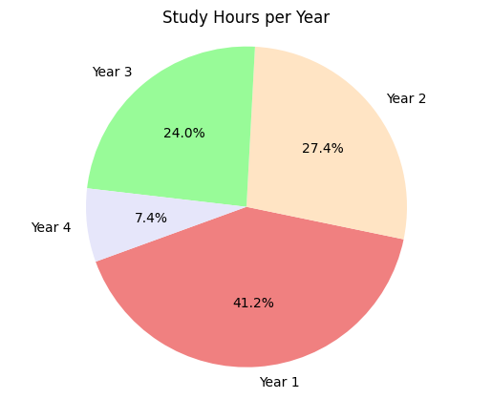
Chart 20: Study Hours per Study Year - Part 1
1. High Study Commitment in Year 1
Year 1 students contribute over 40% of the total study hours.
This could reflect:
High initial motivation or pressure to perform well in university.
More foundational or course-heavy curriculum in first year.
Greater adjustment effort as students transition into tertiary education.
2. Gradual Decline in Study Time
There's a clear drop from Year 1 to Year 4 in study contribution.
By Year 4, students contribute only 7.4% of the total study hours — a significant falloff.
This may be due to:
Increased familiarity with coursework and academic demands.
Lighter course loads or more project/thesis-based formats.
Burnout or shifting priorities (e.g. internships, job searches).

Slide 31
Chart 20: Study Hours per Study Year - Part 2
3. Years 2 and 3 Show Moderate Engagement
Study hours are still substantial in Years 2 and 3 (27.4% and 24.0%, respectively).
Suggests these years remain academically intensive but don’t match the peak intensity of Year 1.
🎓 Implications for Academic Support:
Early academic years may require more structured support, not just because of the workload, but also due to the volume of student effort invested.
The drop in Year 4 could indicate:
A need to explore how to re-engage students in their final year.
An opportunity to evaluate curricular structure and student motivation.
🧩 Conclusion:
Student study behavior appears front-loaded, with the most intense academic effort in Year 1 and a declining trend each subsequent year. This pattern highlights a potential area of focus for educational institutions: sustaining academic motivation and workload management throughout all four years.

Slide 32
Summary - Part 1:
Mental Health Insights
Depression and Anxiety are the most common mental health concerns, with Depression slightly leading at 34.1%.
Age-related trends show that both Depression and No Depression cases are distributed fairly evenly, with no drastic drop or spike in any particular age.
Specialist treatment does not appear to significantly alter sleep quality distribution, though treated individuals show slightly wider variability.
Stress levels remain consistent across ages, with no single age group showing extreme outliers—suggesting stress is a persistent issue throughout student years.
Academic Performance & Engagement
Academic engagement positively correlates with higher CGPA. Students with higher engagement tend to cluster closer to the top GPA range.
Top courses with highest study hours:
Engineering (1739 hrs)
BCS (1718 hrs)
BIT (1097 hrs) This reflects discipline-specific study demands.
Year 1 contributes the most to total study hours (41.2%), followed by a steady decline in subsequent years—possibly indicating burnout, course structure changes, or shifting priorities.

Slide 33
Summary - Part 2:
Support Systems
Across all year groups, the majority of students do not receive support, with support percentages below 15% in every group.
This points to a gap in mental health or academic support accessibility or utilisation.
Overall Takeaways
Students show high academic effort early on, but sustainability of this effort and stress management are concerns.
Despite clear mental health trends, support mechanisms are underutilised.
A strategic focus on early intervention, sustained engagement, and accessible support services could significantly improve student well-being and outcomes.

Slide 34
Thank you for reading!

